Slide 1
Probabilistic Graphical Model
Lin zhang
Sse, tongji university
Dec. 2016

Slide 2
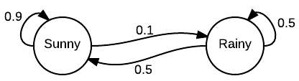
Markov chains
Markov chains were first introduced in 1906 by Andrey Markov, with the goal of showing that the Law of Large Numbers does not necessarily require the random variables to be independent.
A Markov chain is a model that tells us something about the probabilities of sequences of random variables, states, each of which can take on values from some set.
Notes:
The easiest way to explain a Markov chain is by simply looking at one. In this example, we can see we have two states: “sunny” and “rainy”. Let’s say the day is sunny, and we want to know what the chances are that it will be sunny the next day. We can see that the Markov chain indicates that there is a .9, or 90%, chance it will be sunny. Following this pattern, we can see that there will probably be many sunny days lumped together followed by a shorter string of rainy days. It is not certain, but likely.
Obviously, this is not a real world example - this is not how real-world weather models work. However, if one were building a video game that had a “real” weather component, a Markov chain like this may be useful when fed several years of real-time data.

Slide 3
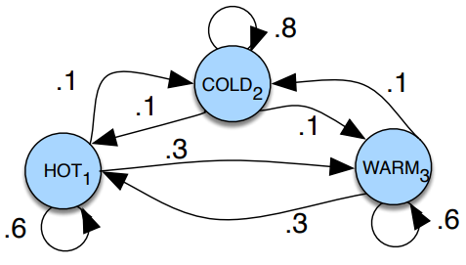

Markov chains
More formally, consider a sequence of state variables $q_{1},q_{2},…,q_{i}$.
A Markov model embodies the Markov assumption on the probabilities of this sequence: that Markov assumption when predicting the future, the past doesn’t matter, only the present.
$P\left(q_{i}=a | q_{1}…q_{i−1}\right)=P\left(q_{i}=a | q_{i−1}\right)$

Slide 4
Markov chains
The states are represented as nodes in the graph, and the transitions, with their probabilities, as edges
The transitions are probabilities: the values of arcs leaving a given state must sum to 1

Slide 5

Markov chains
A Markov chain is specified by the following components:
Set of states $Q=\{ 1, …, K \}$
Transition probabilities between any two states $a_{11}a_{12}…a_{n1}…a_{nn}$, where $a_{ij}$ represents the probability of moving from state i to state j, $s.t. \sum_{j=1}^{n}{a_{ij}}=1 ∀i$
Initial probability distribution over states $a_{01},a_{02},…a_{0n}$, where $a_{0i}$ is the probability that the Markov chain will start in state i

Slide 6

Markov chains
Use the sample probabilities in the figure (with $[a_{01},a_{02},a_{03}]= [0.1,0.7,0.2]$) to compute the probability of each of the following sequences:
hot hot hot hot
cold hot cold hot

Slide 7
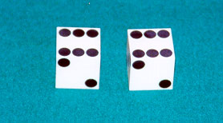
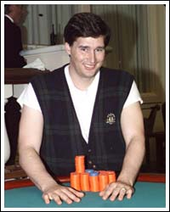
HMM
Example: The dishonest casino
A casino has two dice:
Fair die
P(1) = P(2) = P(3) = P(4) = P(5) = P(6) = 1/6
Loaded die
P(1) = P(2) = P(3) = P(4) = P(5) = 1/10
P(6) = 1/2
Casino player switches between fair and loaded die with probability 1/20 at each turn

Slide 8
HMM
Game
You bet $1
You roll (always with a fair die)
Casino player rolls (maybe with fair die, maybe with loaded die)
Highest number wins $2

Slide 9
Question # 1 – Decoding
GIVEN
A sequence of rolls by the casino player
QUESTION
What portion of the sequence was generated with the fair die, and what portion with the loaded die?
This is the DECODING question in HMMs
1245526462146146136136661664661636616366163616515615115146123562344
FAIR
LOADED
FAIR

Slide 10
Question # 2 – Evaluation
GIVEN
A sequence of rolls by the casino player
QUESTION
How likely is this sequence, given our model of how the casino works?
This is the EVALUATION problem in HMMs
1245526462146146136136661664661636616366163616515615115146123562344
Prob = 1.3 x 10⁻³⁵

Slide 11
Question # 3 – Learning
GIVEN
A sequence of rolls by the casino player
QUESTION
How “loaded” is the loaded die? How “fair” is the fair die? How often does the casino player change from fair to loaded, and back?
This is the LEARNING question in HMMs
1245526462146146136136661664661636616366163616515615115146123562344
Prob(6) = 64%

Slide 12
The dishonest casino model
0.05
0.95
0.95
FAIR
LOADED
0.05
P(1|F) = 1/6
P(2|F) = 1/6
P(3|F) = 1/6
P(4|F) = 1/6
P(5|F) = 1/6
P(6|F) = 1/6
P(1|L) = 1/10
P(2|L) = 1/10
P(3|L) = 1/10
P(4|L) = 1/10
P(5|L) = 1/10
P(6|L) = 1/2

Slide 13

An HMM is memoryless
At each time step t, the only thing that affects future states is the current state $π_{t}$
$P(π_{t+1}=k | “whatever happened so far”)$
$=P\left(π_{t+1}=k \right|π_{1}, π_{2},…,π_{t},x_{1}, x_{2}, …, x_{t})$
$=P\left(π_{t+1}=k \right|π_{t})$
1
2
K
…

Slide 14

An HMM is memoryless
At each time step t, the only thing that affects $x_{t}$ is the current state $π_{t}$
$P(x_{t}=b | “whatever happened so far”)$
$=P\left(x_{t}=b\right|π_{1}, π_{2},…,π_{t},x_{1}, x_{2}, …, x_{t})$
$=P\left(x_{t}=b\right|π_{t})$
1
2
K
…

Slide 15
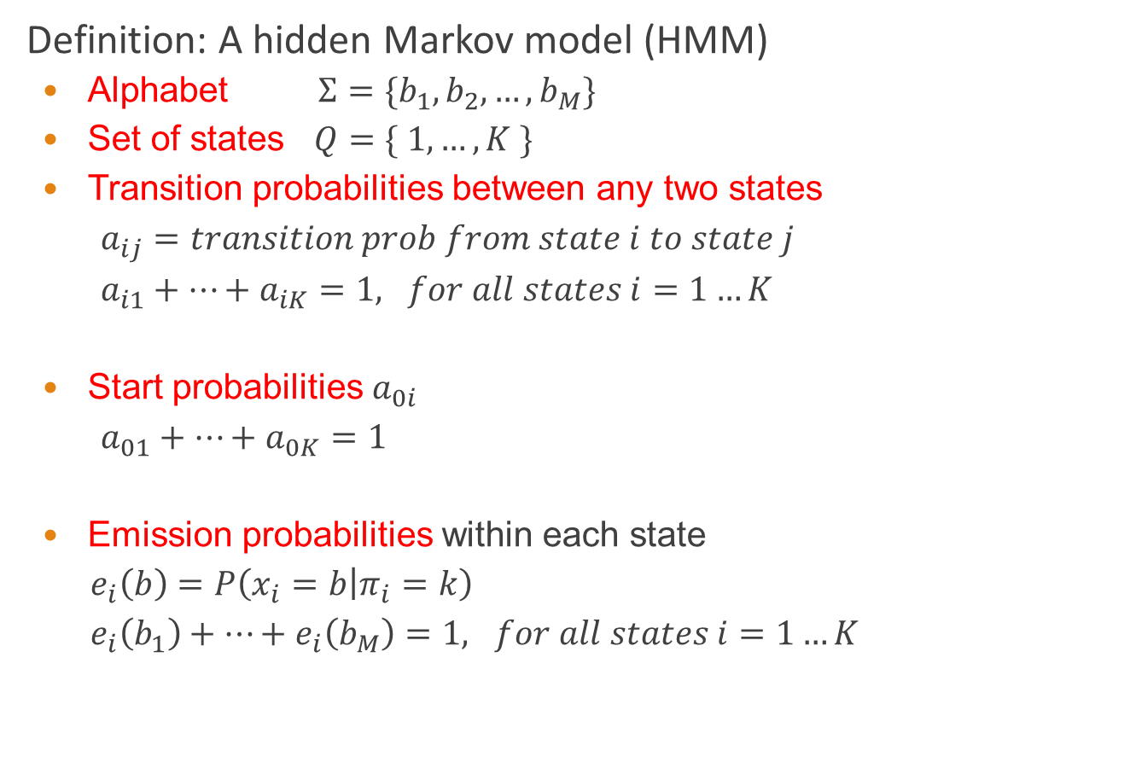
Definition of HMM
Definition: A hidden Markov model (HMM)
Alphabet $Σ=\{b_{1}, b_{2}, …, b_{M}\}$
Set of states $Q=\{ 1, …, K \}$
Transition probabilities between any two states
$a_{ij}=transition prob from state i to state j$
$a_{i1}+…+a_{iK}=1, for all states i=1…K$
Start probabilities $a_{0i}$
$a_{01}+…+a_{0K}=1$
Emission probabilities within each state
$e_{i}\left(b\right)=P\left(x_{i}=b | π_{i}=k\right)$
$e_{i}\left(b_{1}\right)+…+e_{i}\left(b_{M}\right)=1, for all states i=1…K$
1
2
K
…

Slide 16





A parse of a sequence
Given a sequence $x=x_{1}…x_{N}$,
A parse of x is a sequence of states $π=π_{1},…,π_{N}$
1
1
1
1
…
1
2
2
2
2
2
…
2
…
…
…
…
K
K
K
K
…
K
$$x_{1}$$
$$x_{2}$$
$$x_{3}$$
$$x_{N}$$

Slide 17







Generating a sequence by the model
Given a HMM, we can generate a sequence of length N as follows:
Start at state $π_{1}$ according to prob $a_{0π_{1}}$
Emit letter $x_{1}$ according to prob $e_{π_{1}}(x_{1})$
Go to state $π_{2}$ according to prob $a_{π_{1}π_{2}}$
… until emitting $x_{N}$
1
1
1
1
…
1
$$a02$$
2
2
2
2
2
…
2
0
…
…
…
…
K
K
K
K
…
K
$$e2(x1)$$
$$x_{1}$$
$$x_{2}$$
$$x_{3}$$
$$x_{N}$$

Slide 18
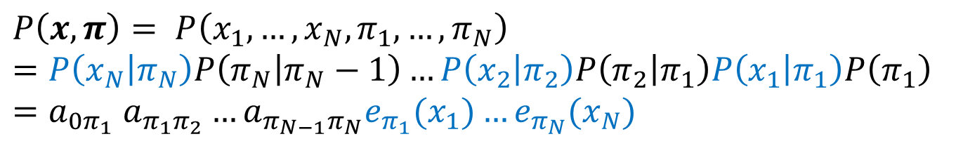





Likelihood of a parse
Given a sequence $x=x_{1}…x_{N}$ and a parse $π=π_{1},…π_{N}$,
To find how likely this scenario is: (given our HMM)
1
1
1
1
…
1
2
2
2
2
2
…
2
…
…
…
…
K
K
K
K
K
…
$$x_{1}$$
$$x_{2}$$
$$x_{3}$$
$$x_{N}$$
$$P\left(x, π\right)= P\left(x_{1}, …, x_{N}, π_{1}, …, π_{N}\right)=P\left(x_{N} | π_{N}\right)P\left(π_{N} | π_{N}−1\right)…P\left(x_{2} | π_{2}\right)P\left(π_{2} | π_{1}\right)P\left(x_{1} | π_{1}\right)P\left(π_{1}\right)$$
$$=a_{0π_{1}} a_{π_{1}π_{2}}…a_{π_{N−1}π_{N}}e_{π_{1}}(x_{1})…e_{π_{N}}(x_{N})$$

Slide 19
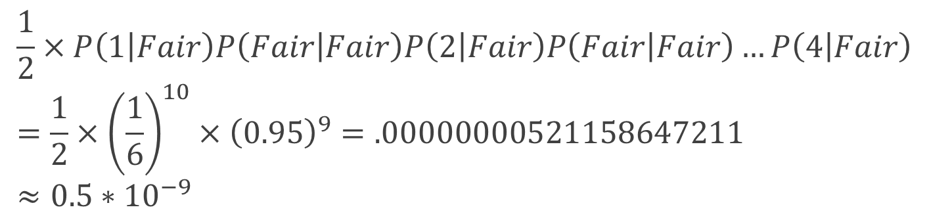

Example: the dishonest casino
Let the sequence of rolls be:
$x=1, 2, 1, 5, 6, 2, 1, 5, 2, 4$
Then, what is the likelihood of
$π=Fair, Fair, Fair, Fair, Fair, Fair, Fair, Fair, Fair, Fair$?
(say initial probs $a_{0Fair}=½, a_{0Loaded}=½$)
So, the likelihood the die is fair in this run is just $0.521×{10}^{−9}$
$$\frac{1}{2}×P\left(1 | Fair\right)P\left(Fair | Fair\right)P\left(2 | Fair\right)P\left(Fair | Fair\right)…P\left(4 | Fair\right)=\frac{1}{2}×{\left(\frac{1}{6}\right)}^{10}×{\left(0.95\right)}^{9}=.00000000521158647211≈0.5∗{10}^{−9}$$

Slide 20
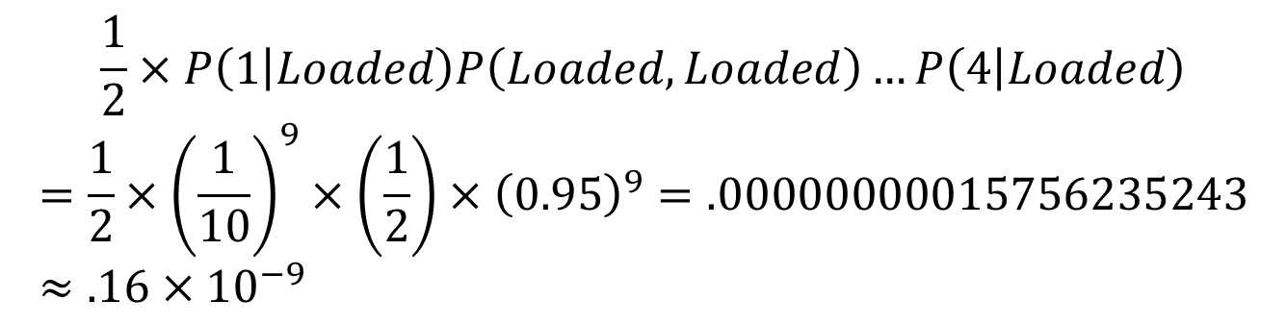

Example: the dishonest casino
What is the likelihood of
$π=Loaded, Loaded, Loaded, Loaded, Loaded, Loaded,$
$Loaded, Loaded, Loaded, Loaded$?
Therefore, it’s somewhat more likely that all the rolls are done with the fair die, than that they are all done with the loaded die
$$\frac{1}{2}×P\left(1 | Loaded\right)P\left(Loaded, Loaded\right)…P\left(4 | Loaded\right)$$
$$=\frac{1}{2}×{\left(\frac{1}{10}\right)}^{9}×\left(\frac{1}{2}\right)×{\left(0.95\right)}^{9}=.00000000015756235243≈.16×{10}^{−9}$$

Slide 21
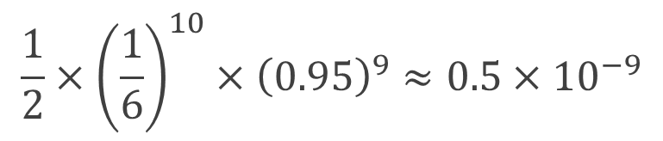
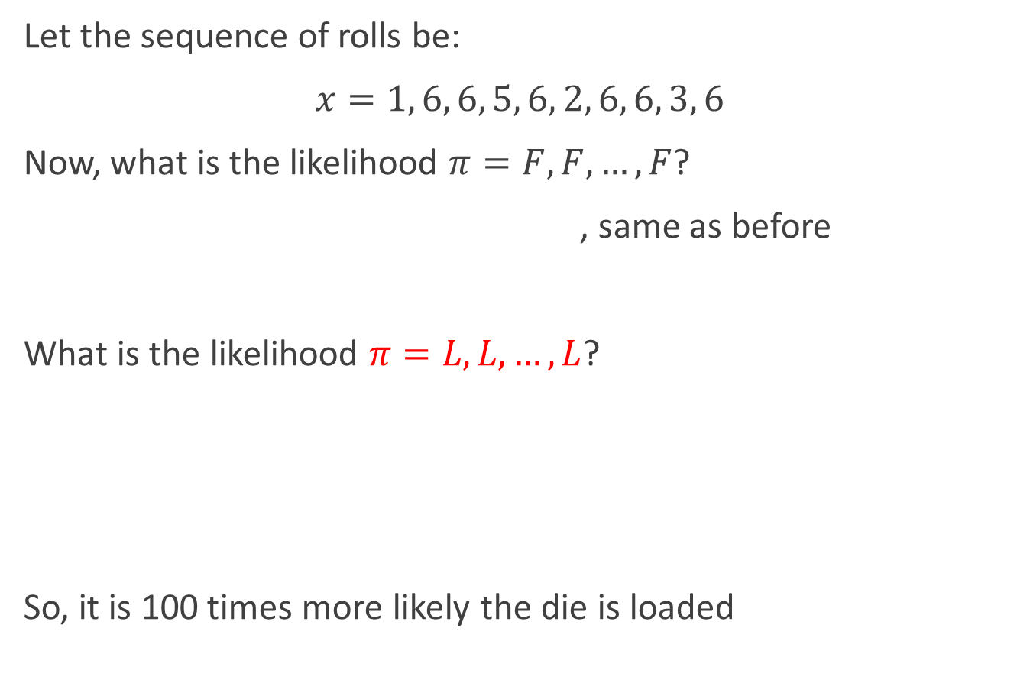
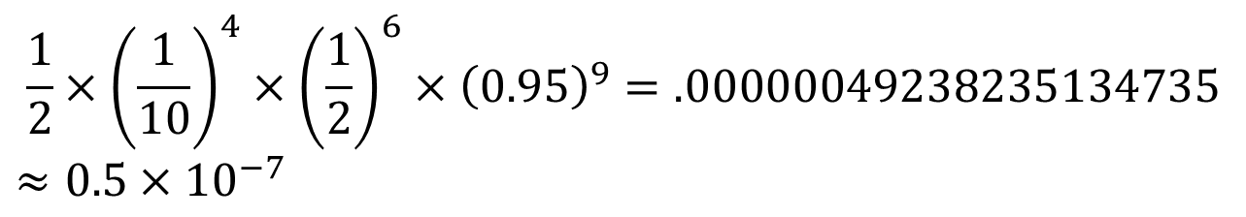
Example: the dishonest casino
Let the sequence of rolls be:
$x=1, 6, 6, 5, 6, 2, 6, 6, 3, 6$
Now, what is the likelihood $π=F, F, …, F$?
, same as before
What is the likelihood $π=L, L, …, L$?
So, it is 100 times more likely the die is loaded
$$\frac{1}{2}×{\left(\frac{1}{6}\right)}^{10}×{\left(0.95\right)}^{9}≈0.5×{10}^{−9}$$
$$\frac{1}{2}×{\left(\frac{1}{10}\right)}^{4}×{\left(\frac{1}{2}\right)}^{6}×{\left(0.95\right)}^{9}=.00000049238235134735$$
$$≈0.5×{10}^{−7}$$

Slide 22
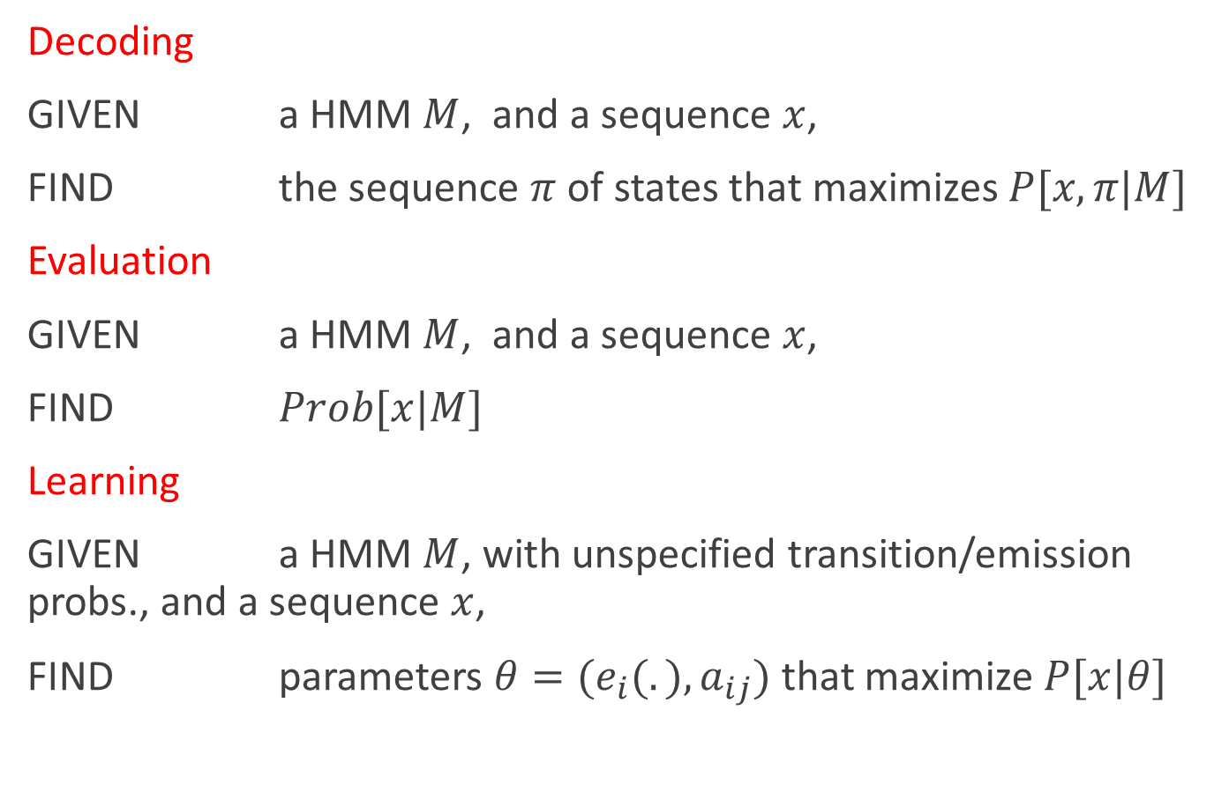
The three main questions on HMMs
Decoding
GIVEN a HMM $M$, and a sequence $x$,
FIND the sequence $π$ of states that maximizes $P[x, π|M]$
Evaluation
GIVEN a HMM $M$, and a sequence $x$,
FIND $Prob[x|M]$
Learning
GIVEN a HMM $M$, with unspecified transition/emission probs., and a sequence $x$,
FIND parameters $θ=(e_{i}(.), a_{ij})$that maximize $P[x|θ]$

Slide 23
Another example: Teacher-mood-model
The observation is a probabilistic function of the state.
Situation:
Your school teacher gave three different types of daily homework assignments:
A: took about 5 minutes to complete
B: took about 1 hour to complete
C: took about 3 hours to complete
Your teacher did not reveal openly his mood to you daily, but you knew that your teacher was either in a bad, neutral, or a good mood for a whole day.
Mood changes occurred only overnight.
Question How were his moods related to the homework type assigned that day?

Slide 24
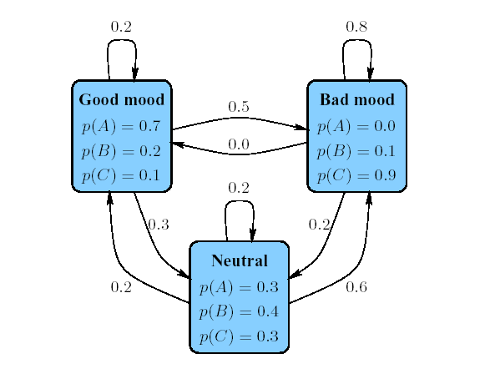
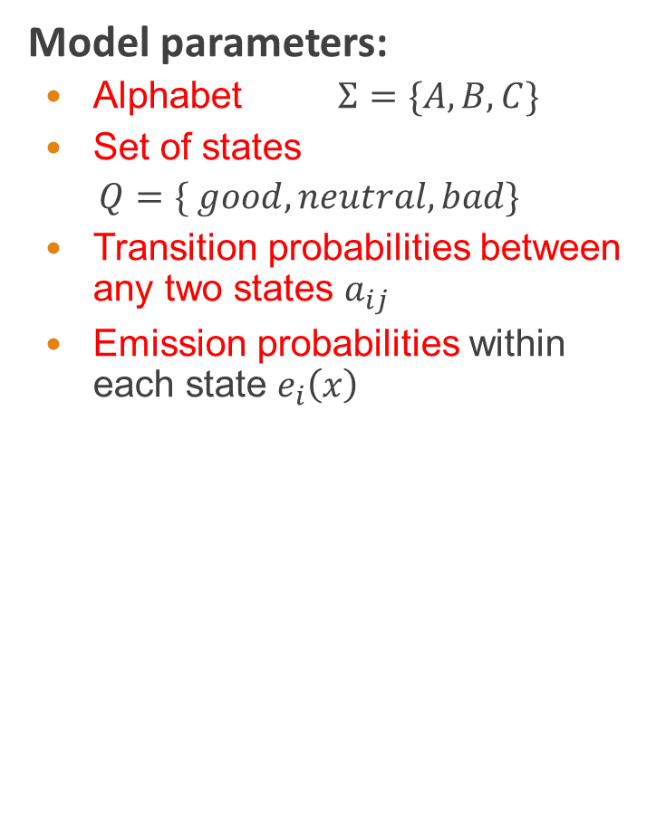
Another example: Teacher-mood-model
Model parameters:
Alphabet $Σ=\{A, B,C\}$
Set of states
$$Q=\{ good, neutral, bad\}$$
Transition probabilities between any two states $a_{ij}$
Emission probabilities within each state $e_{i}\left(x\right)$

Slide 25
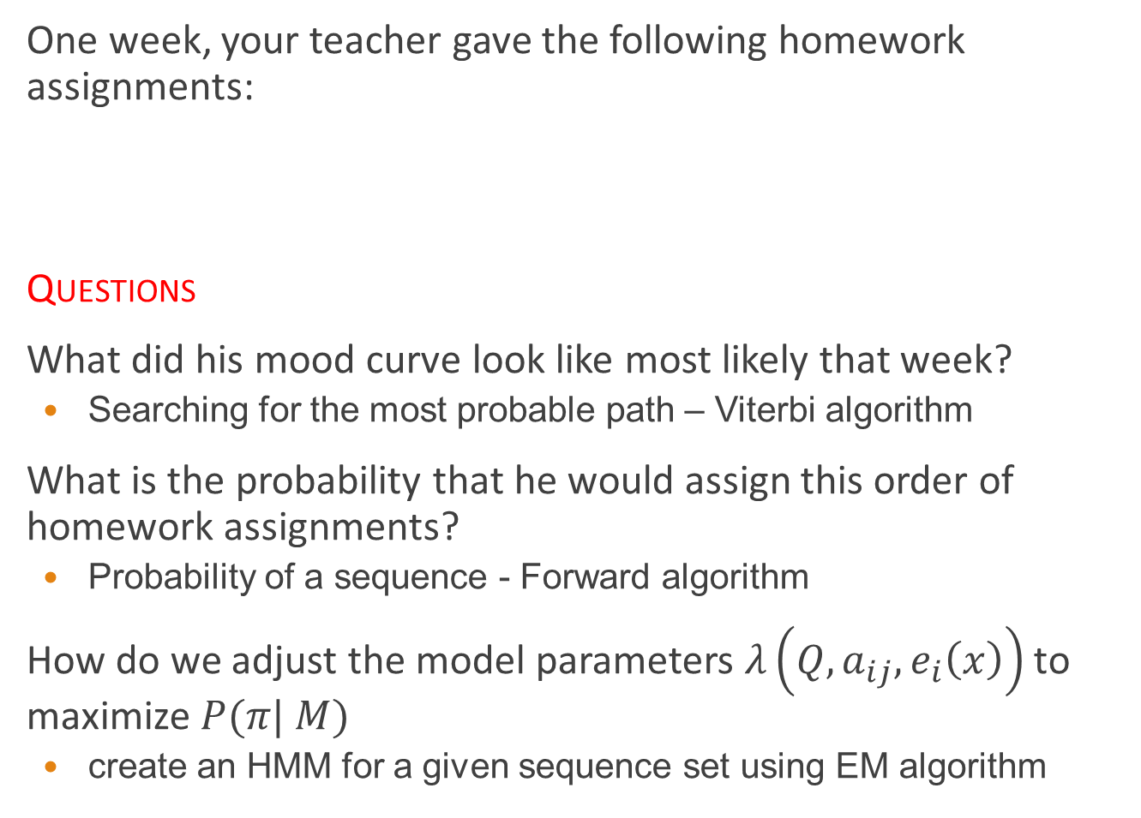
Another example: Teacher-mood-model
One week, your teacher gave the following homework assignments:
Questions
What did his mood curve look like most likely that week?
Searching for the most probable path – Viterbi algorithm
What is the probability that he would assign this order of homework assignments?
Probability of a sequence - Forward algorithm
How do we adjust the model parameters $λ\left(Q,a_{ij},e_{i}\left(x\right)\right)$to maximize $P(π| M)$
create an HMM for a given sequence set using EM algorithm
Monday | Tuesday | Wednesday | Thursday | Friday
A | C | B | A | C

Slide 26
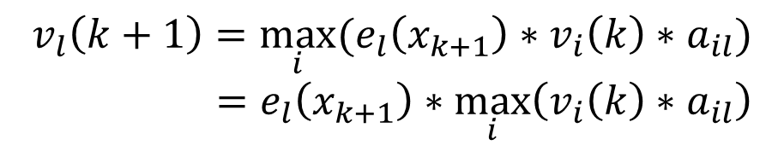
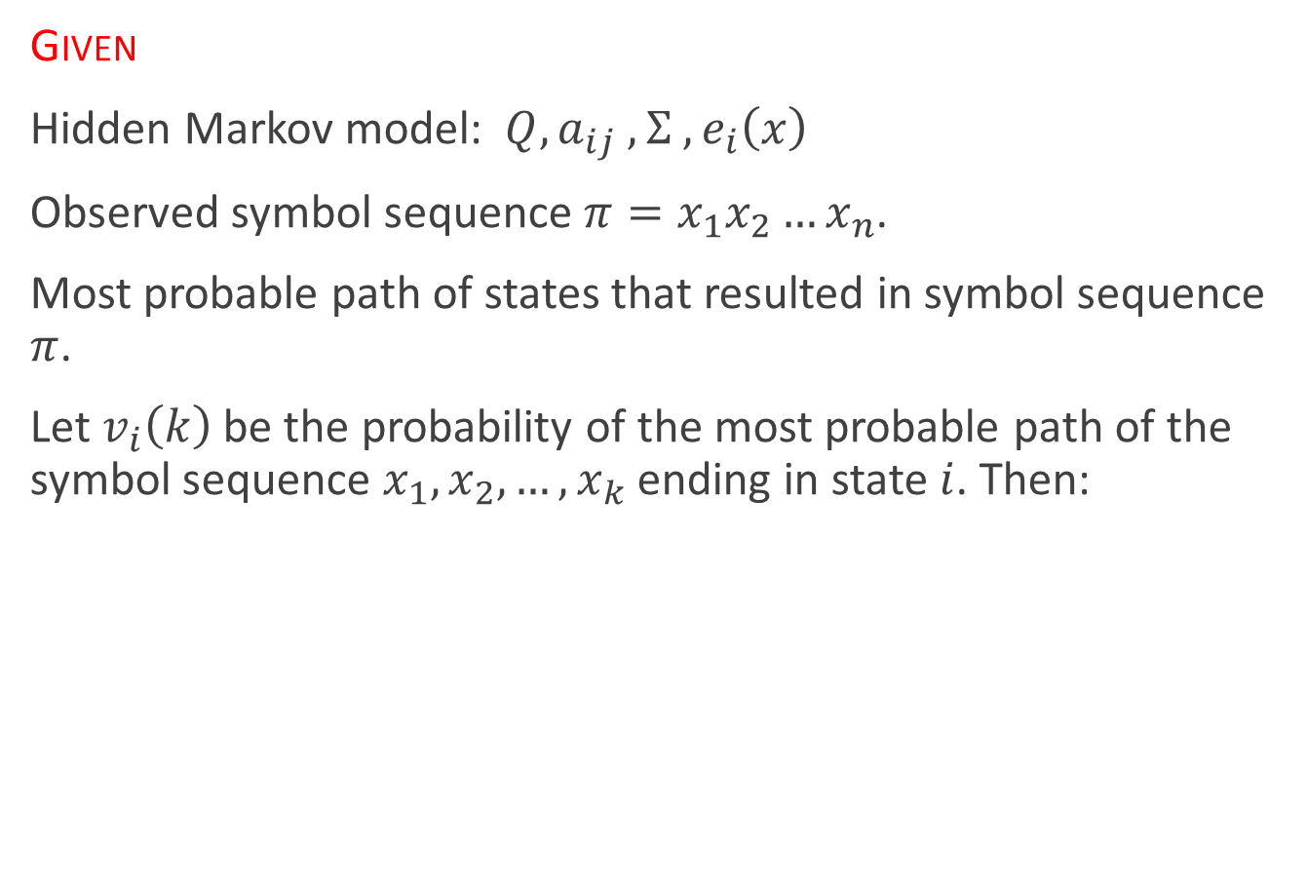
HMM: Viterbi algorithm
Given
Hidden Markov model: $Q, a_{ij} ,Σ ,e_{i}\left(x\right)$
Observed symbol sequence $π=x_{1}x_{2}…x_{n}$.
Most probable path of states that resulted in symbol sequence $π$.
Let $v_{i}\left(k\right)$ be the probability of the most probable path of the symbol sequence $x_{1},x_{2},…,x_{k}$ ending in state $i$. Then:
$$v_{l}\left(k+1\right)=\max_{i}{(e_{l}\left(x_{k+1}\right)∗v_{i}\left(k\right)∗a_{il})}$$
$$=e_{l}\left(x_{k+1}\right)∗\max_{i}\left(v_{i}\left(k\right)∗a_{il}\right)$$

Slide 27
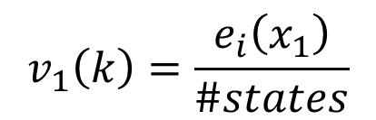

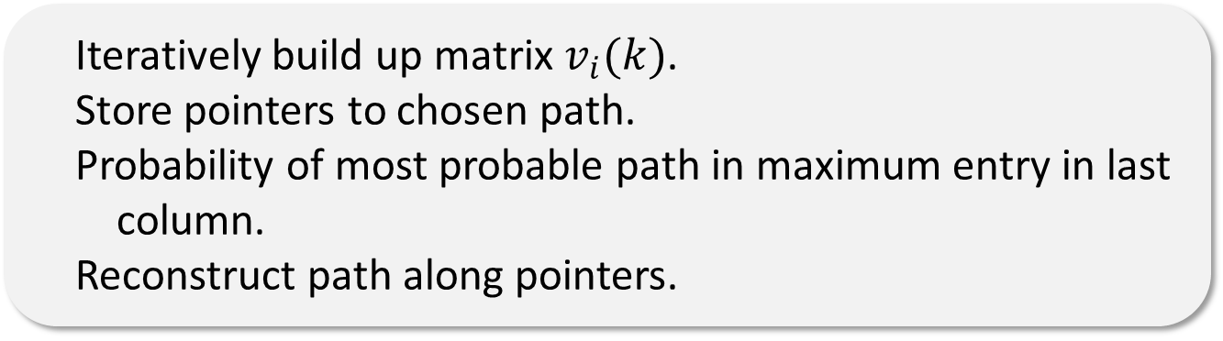
HMM: Viterbi algorithm
Matrix $v_{i}(k)$, where $k∈Q$ and $1≤l≤ n$.
Initialization: for all states $k∈Q$ .
$v_{l}\left(k\right)=e_{l}\left(x_{i}\right)\max_{i}{(v_{i}\left(k − 1\right)a_{il}})$for all states $k∈Q,i≥2$.
Algorithm
$$v_{1}\left(k\right)=\frac{e_{i}\left(x_{1}\right)}{\#states}$$
Iteratively build up matrix $v_{i}(k)$.
Store pointers to chosen path.
Probability of most probable path in maximum entry in last column.
Reconstruct path along pointers.

Slide 28
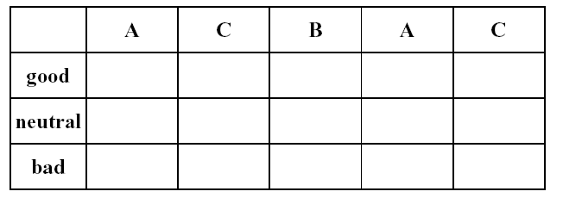
HMM: Viterbi algorithm
Empty table

Slide 29
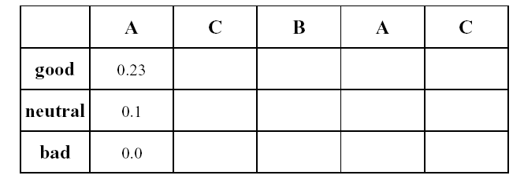

HMM: Viterbi algorithm
Initialization:
$$v_{l}\left(1\right)=\frac{e_{l}\left(A\right)}{\#states}$$

Slide 30
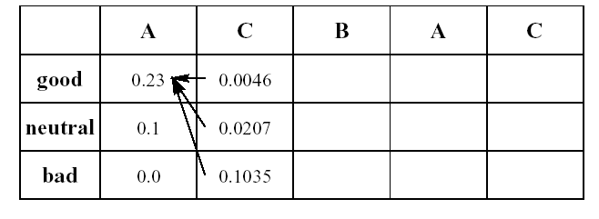

HMM: Viterbi algorithm
$v_{l}\left(2\right)=e_{l}\left(C\right)\max_{i}{(v_{i}\left(1\right)a_{il})}$

Slide 31
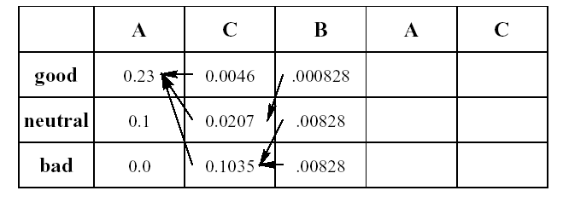

HMM: Viterbi algorithm
$v_{l}\left(3\right)=e_{l}\left(B\right)\max_{i}{(v_{i}\left(2\right)a_{il})}$

Slide 32
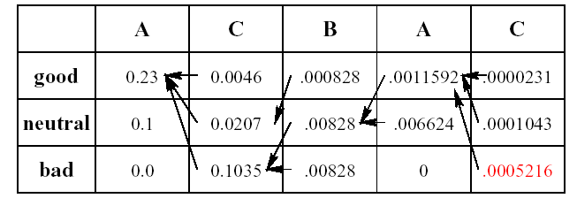
HMM: Viterbi algorithm
Maximum entry in last column

Slide 33
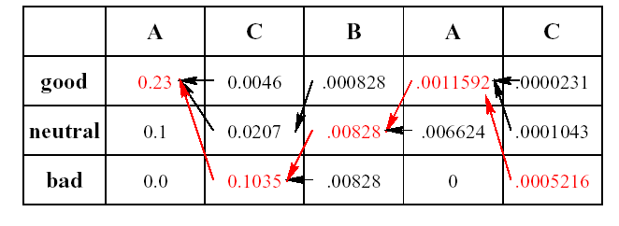
HMM: Viterbi algorithm
Reconstruct path along pointers

Slide 34
HMM: Viterbi algorithm
Question
What did his mood curve look like most likely that week?
Answer
Most probable mood curve:
Day | Monday | Tuesday | Wednesday | Thursday | Friday
Assignment | A | C | B | A | C
Mood | good | bad | neutral | good | bad

Slide 35

HMM: Parameter estimation
Question
How do we know the transition probabilities $a_{ij}$ and the emission probabilities $e_{i}(x)$?
Answer
We use training sequences and construct maximum likelihood estimators.

Slide 36

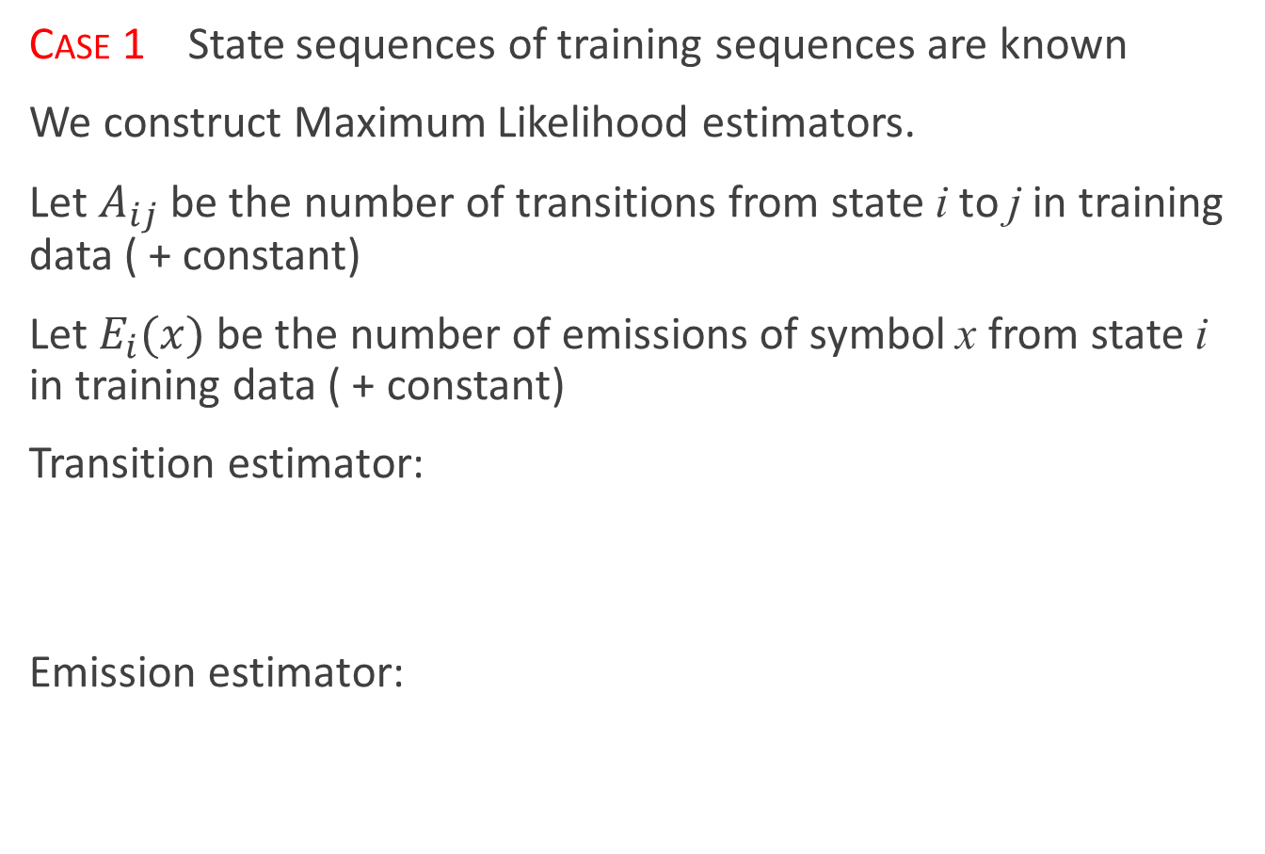
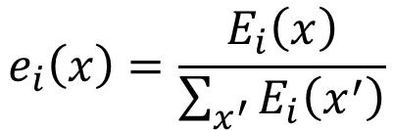
HMM: Parameter estimation
Case 1 State sequences of training sequences are known
We construct Maximum Likelihood estimators.
Let $A_{ij}$ be the number of transitions from state i to j in training data ( + constant)
Let $E_{i}(x)$ be the number of emissions of symbol x from state i in training data ( + constant)
Transition estimator:
Emission estimator:
$$a_{ij}=\frac{A_{ij}}{\sum_{j^{′}}{A_{ij^{′}}}}$$
$$e_{i}\left(x\right)=\frac{E_{i}\left(x\right)}{\sum_{x^{′}}{E_{i}\left(x^{′}\right)}}$$

Slide 37
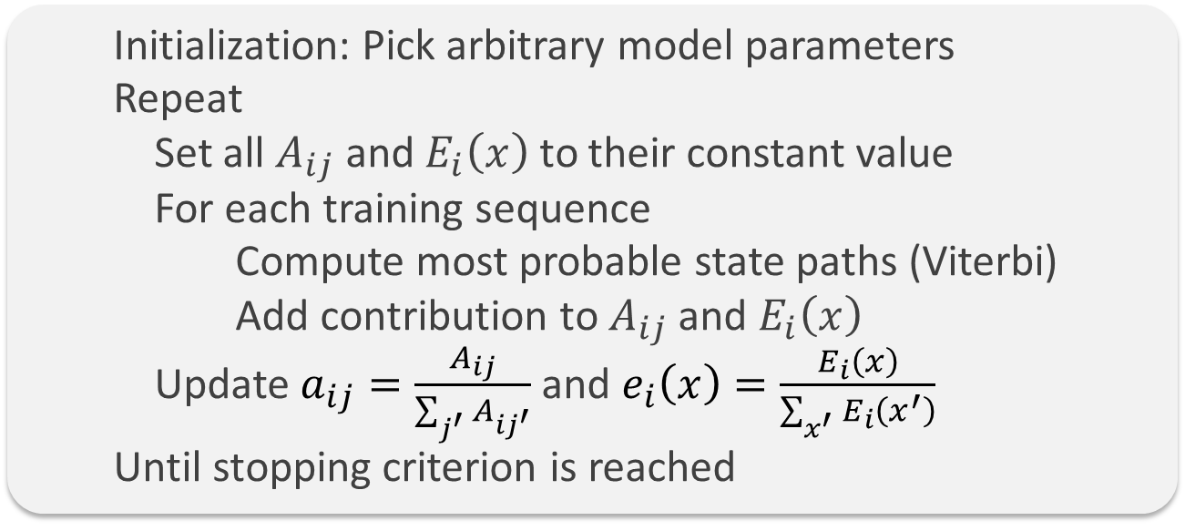
HMM: Parameter estimation
Case 2 State sequences of training sequences are not known
Viterbi training We iteratively use the Viterbi algorithm to compute the most probable paths and set the parameters (from case 1) according to this data
Algorithm sketch:
Initialization: Pick arbitrary model parameters
Repeat
Set all $A_{ij}$ and $E_{i}\left(x\right)$ to their constant value
For each training sequence
Compute most probable state paths (Viterbi)
Add contribution to $A_{ij}$ and $E_{i}\left(x\right)$
Update $a_{ij}=\frac{A_{ij}}{\sum_{j^{′}}{A_{ij^{′}}}}$ and $e_{i}\left(x\right)=\frac{E_{i}\left(x\right)}{\sum_{x^{′}}{E_{i}\left(x^{′}\right)}}$
Until stopping criterion is reached

